Slide 1
Academic Honesty and
Intellectual Property Rights
Ken Baclawski
College of Computer and Information Science
Northeastern University

Slide 2
Why is Academic Honesty Important?
Your diploma represents the University’s certification that you have attained a certain level of knowledge in your program.
Your grade in this course represents my certification that you have attained a certain level of knowledge in this course.
“You” means you, not “you with a little help from your friends.”

Slide 3
Who cares?
Employers care.
  When they see an NU diploma, they expect that individual to have reached a certain level of achievement
Faculty and Advisors care.
  When they see a grade in this course, they expect that individual to have reached a certain level of knowledge.

Slide 4
Who else cares?
Your classmates care.
  An honest student gets angry when his or her classmate gets a reward without putting in the effort.
The University cares.
  Every time a student goes out into the world with an NU diploma and doesn’t perform well, it makes the whole University look bad.

Slide 5
CCIS Cheating Policy
All violations of the University academic integrity policy must be reported to OSCCR.
  OSCCR = Office of Student Conduct and Conflict Resolution.
Students who cheat often do so in multiple courses. By reporting all violations to OSCCR, we guarantee that such students are suitably punished.

Slide 6
University Academic Integrity Policy
The following slides give a broad overview, but not an all-encompassing definition, of what constitutes a violation of academic integrity
  This overview is based on the OSCCR website at http://www.northeastern.edu/osccr/
  Examples are also shown.

Slide 7
Cheating
The University defines cheating as using or attempting to use unauthorized materials, information, or study aids in any academic exercise. When completing any academic assignment, a student shall rely on his or her own mastery of the subject.
  For example, posting a homework problem on a public website devoted to such problems.

Slide 8
Fabrication
The University defines fabrication as falsification, misrepresentation, or invention of any information, data, or citation in an academic exercise.

Slide 9
Plagiarism
The University defines plagiarism as using as one’s own the words, ideas, data, code, or other original academic material of another without providing proper citation or attribution. Plagiarism can apply to any assignment, either final or drafted copies, and it can occur either accidentally or deliberately. Claiming that one has “forgotten” to document ideas or material taken from another source does not exempt one from plagiarizing.
  An example of a citation was shown on the University Academic Integrity Policy slide above.
  An attribution is shown in a later slide.

Slide 10
Plagiarism
Publicly posting an entire document or part of a document (for example, on Facebook) is plagiarism even if the source is properly cited, except in the following cases:
  The part that is posted is small. This is known as “fair use.” For the definition of “fair use” see http://en.wikipedia.org/wiki/Fair_use
  The copyright notice allows such posting.
Publicly posting a document without proper authorization can have serious consequences:
  The author may no longer be able to publish the document in a journal or conference.
  You could be sued for damages.
  In some countries, you could go to prison.

Slide 11
Unauthorized Collaboration
The University defines unauthorized collaboration as instances when students submit individual academic works that are substantially similar to one another. While several students may have the same source material, any analysis, interpretation, or reporting of data required by an assignment must be each individual’s independent work unless the instructor has explicitly granted permission for group work.

Slide 12
Unauthorized Collaboration
This is one of the most common examples of academic dishonesty.
  For example, a group of classmates are discussing the course material, and one of them mentions a problem on a homework assignment (or one similar to it). Discussing this problem in the group is an unauthorized collaboration.
  In summary: discussing course material with classmates is acceptable, but discussing a homework assignment problem (or a problem similar to it) is unacceptable.
  Asking someone outside the course for help with your homework assignments is also an example of cheating.

Slide 13
Participation in
Academically Dishonest Activities
The University defines participation in academically dishonest activities as any action taken by a student with the intention of gaining an unfair advantage over other students.
  Sharing files or portions of files is unacceptable.
  Copying another student's file is unacceptable.
  Even looking at another student's work is unacceptable.

Slide 14
What happens if you get caught?
You will get called to my office and I will show you what you did.
You will receive a grade penalty in the course.
You will be sent to OSCCR.
  They will assign a non-academic penalty (typically some form of suspension, possibly deferred if there are no future violations)
  A second OSCCR violation typically results in expulsion from the University.

Slide 15
What happens if you don't get caught?
You will do poorly on the Final Exam.
  The Final Exam will have problems similar to the homework assignment problems.
You go on to the next course, and do poorly because you are unprepared.
You go out on an interview, and do poorly because you are unprepared.
You manage to get a job, but do poorly because you are unprepared.
Your co-op employer is so disappointed by your performance that he or she decides not to interview any more NU students.

Slide 16
Avoiding Problems
Students typically report that a course requires about 10 to 20 hours of work per week, so budget your time accordingly.
Students who are under time pressure are far more likely to resort to theft.
Time pressure or stress is not an acceptable excuse.
The measure of character is not what you do when things are easy; it is what you do when things get tough.

Slide 17
Avoiding Problems
Guard your work!
If you keep your work on your home machine, be sure your machine is secure, both from Internet hostiles and from your roommates, etc.
  It only takes a minute for your roommate, or for the person sitting next to you in the hallway, to stick a USB drive in your machine and steal your work.
Don't discount this; we have encountered theft by roommates on a regular basis in the past.
  Remember that physical security is a prerequisite for information security.

Slide 18
Piazza Discussions
It is especially important to be careful when one is participating in a discussion on Piazza.
Asking questions is very important!
However, it is not appropriate to ask for the answer to a homework assignment.
When in doubt, post a private question. If the question is appropriate, then it can be made public later.

Slide 19
Piazza Example
Example: On an assignment, one of the questions asked for the asymptotic complexity of an algorithm described using pseudo-code.
Which of these would be appropriate?
  “In the pseudo-code for the algorithm, is the parameter N always greater than 1?”
  “I am not sure how to approach this problem, can anyone tell me the asymptotic complexity and how to prove it?”

Slide 20
Piazza Appropriateness
“In the pseudo-code for the algorithm, is the parameter N always greater than 1?”
  This is an appropriate question. It is asking for clarification about the problem, not how to solve it.
“I am not sure how to approach this problem, can anyone tell me the asymptotic complexity and how to prove it?”
  It should be obvious that this is inappropriate. It is asking how to solve the problem.
What is appropriate?
  Piazza questions related to homework assignments must be about the problems, not how to solve them.

Slide 21
Piazza Etiquette
Always post a single question.
  Multiple questions in a single post are difficult to answer and even more difficult to discuss.
  Answers often will not mention which part of a multi-part posting is being discussed, leading to confusion and tedious discussions about discussions.
  If you post a multi-part question, I will only answer the first part, and will delete the others.
  Please post each question separately. It is not difficult to copy and paste if some parts are repeated.

Slide 22
Piazza Etiquette
Stay on the topic in a discussion
  All discussion must be related to the original posting.
  An unrelated question must be posted as an independent top-level post.
For example, consider this response in a discussion:
  “Thanks, that answers my question about the Jarnik algorithm. Also, can you tell me what room the final exam will be in?”
  Needless to say, the question about the final exam is not on the original topic. It should be a separate post.

Slide 23
TA Etiquette
The TAs will post their office hours on Piazza
The same appropriateness criteria apply to TA questions.
Example of Inappropriate Question

Slide 24
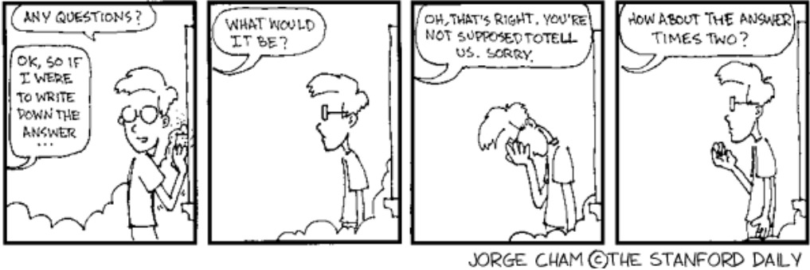
Inappropriate Questions

Slide 25
Questions
I know that most of you are honest, and none of this will apply to you if you are honest BUT academic dishonesty happens often enough that we need to have policies about it, and you need to know them.
If you have any questions about any actions that you have done or are thinking about, please come talk to the course staff immediately.
You can send me a private message on Piazza.

Slide 26
Copyrights
Displaying a copyright notice in your document is not required in the U.S. and most other countries. In these countries, copyright is automatically given to the author as soon as the material is published.
  It follows that copying from a document without proper permission and citation is plagiarism even when the document has no formal copyright notice.
A formal copyright notice is primarily used for specifying a LESS restrictive license.
  By default, every document belongs exclusively to the copyright holder, and any use (other than “fair use”) requires permission.
  See http://en.wikipedia.org/wiki/Fair_use for the definition of “fair use” in the U.S.

Slide 27
Copyright Notice Format
The proper format for a copyright notice is the following:
© 2013 Kenneth Baclawski. All rights reserved. This document is available under the Simplified BSD License at http://opensource.org/licenses/BSD-2-Clause
  Instead of using the © symbol one can write "Copyright (c)" or various abbreviations.
  The date can be a range of years or list of years rather than a single year.
  The name can be a single name, a list of names or an organization.
  The license terms can be written out in full rather than provided by a link.

Slide 28
Attribution and Copyright Notices for this document
This is Mitchell Wand's copyright notice in the original document from which this document is derived:
© Mitchell Wand, 2012-2013 This work is licensed under a Creative Commons Attribution-NonCommercial 3.0 Unported License
This document also has the following copyright notice:
© 2013 Kenneth Baclawski. All rights reserved. This document is available under the Simplified BSD License
Note that both licenses apply to these slides.
The notice(s) should normally be on the first or last page.

